Slide 2
‘Phuzzing’ – Fuzzing in Physics
Injecting unexpected inputs to find unexpected results
PRESENTED BY George O’Neill

Slide 3
Agenda
What
Why
How
Concepts
Real-world

Slide 4
What
What is fuzzing?
Random testing
Around forever (punch cards!) but formalised in 1988
Typically automated
Can be ‘dumb’ (random, mutation) or ‘smart’ (led by knowledge of inputs, grammar)
Huge security applications
Google detected 20k vulnerabilities in Chrome (2019), US DoD requires fuzz testing
Should reliably show a problem in a simple way…it finds bugs!
Barton P. Miller, Louis Fredriksen, and Bryan So. 1990. An empirical study of the reliability of UNIX utilities. Commun. ACM 33, 12 (Dec. 1990), 32–44. https://doi.org/10.1145/96267.96279

Slide 5
Why
Why use fuzzing?
Computers are controlled by logic, but with nuances...
Interruptions, hardware bugs, users…
Assumption is that all code has bugs, somewhere
Fuzzing can be done quickly and easily
Makes it cost-effective in terms of time vs manual tests
It maximises portability
‘Machine’ approach (rather than human approach)
Often the only way to probe closed source programs
Safety critical
Can be useful even against code with 100% test coverage
T
U

Slide 6
How
How do you get something worthwhile from fuzzing?
We need a ‘Poet’, a ‘Courier’, and an ’Oracle’
We need to know what a ’good’ and ‘bad’ response look like
We need to be able to determine why we reach an unintended state
All easy to imagine with e.g. web application using URL tokens
Harder to envisage a complicated system using many inherited classes and dependencies

Slide 7
The Poet
Input
The writing of the fuzzing
Can always edit and add and evolve
Dumb or smart…or both?
Modify & Substitute
Try to cover all paths

Slide 8
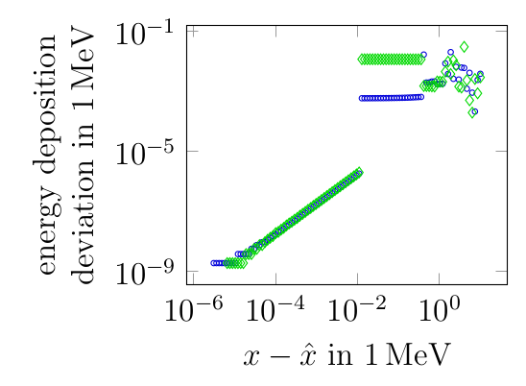
The Courier
Sender
Deliver the fuzzing
Miller ‘discovered’ the idea of fuzzing when connected over 1980s dial-up network!
Remote is particularly important
Hardware can cause issues
C++ not memory safe, (pure) Python is
Keep process open to accumulate inputs?

Slide 9
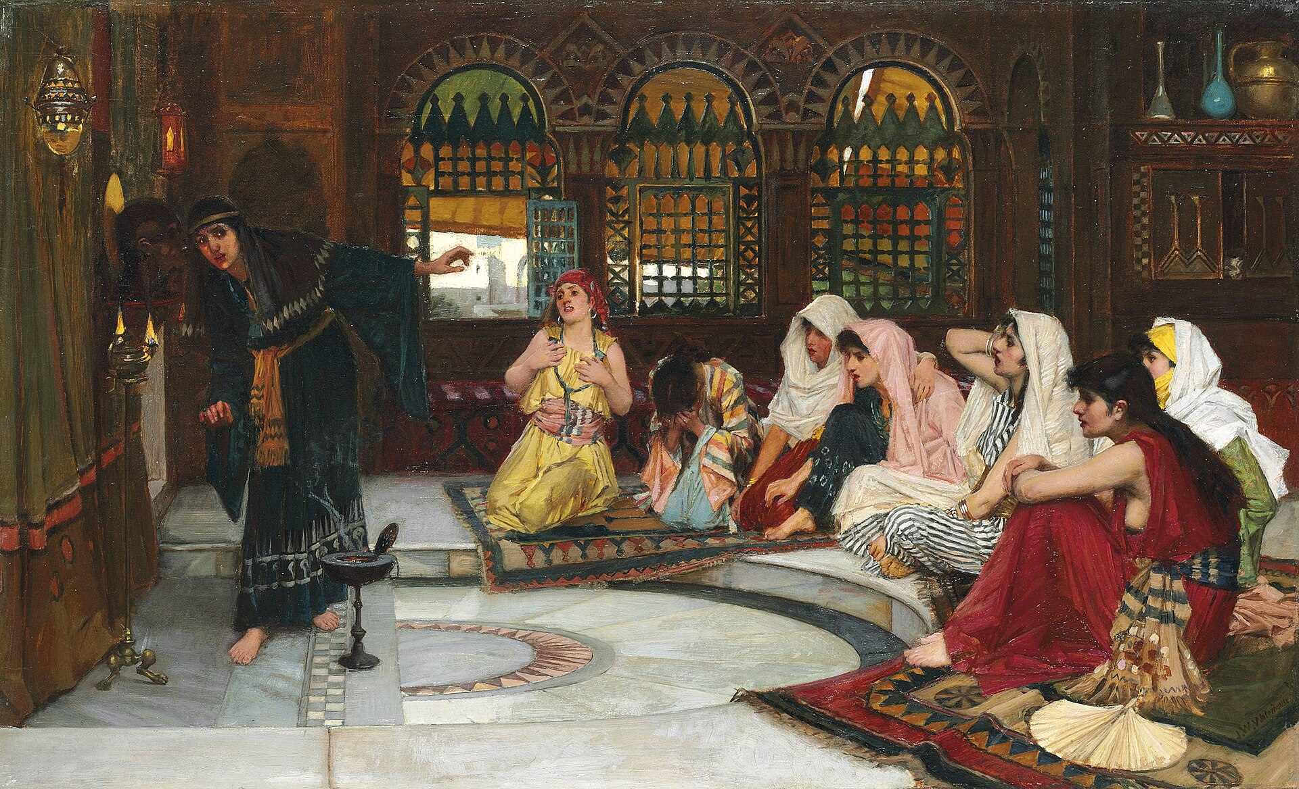
The Oracle
All-knowing
Good data in should mean good data out and vice versa
Bad data should be handled ‘well’ but not ‘good’
Crashing is an unreliable method to handle bad data, but better than using it!
Know when good data out is not the same as correct data out…

Slide 10
Cut seamlessly to terminal...

Slide 11
Inputs
STARTING
-1
0
0.0
1
10
-10
3.1415926535897932384626433832795028841971
2147483647
2147483648
4294967295
4294967296
-2147483647
-2147483648
4
-4294967295
-4294967296
1e2
1.0e2
13e3
1.3e4
13.4e3
2.1e10^308
9.5e10^308
39.5e10^308
-1.9e10^308
-19.2e10^308
0.00000000000001
-0.00000000000001
0.0000g000000001
-0.0000g000000001
g-1
g0
g0.0
g1
g10
g-10
g3.1415926535897932384626433832795028841971
g2147483647
g2147483648
g4294967295
g4294967296
g-2147483647
g-2147483648
g-4294967295
g-4294967296
-g2147483647
-g2147483648
-g4294967295
-g4294967296
g-1g
g0g
g0.0g
g1g
g10g
g-10g
g3.1415926535897932384626433832795028841971g
g2147483647g
g2147483648g
g4294967295g
g4294967296g
5
g-2147483647g
g-2147483648g
g-4294967295g
g-4294967296g
-g2147483647g
-g2147483648g
-g4294967295g
-g4294967296g
-1g
0g
0.0g
1g
10g
-10g
3.1415926535897932384626433832795028841971g
2147483647g
2147483648g
4294967295g
4294967296g
-2147483647g
-2147483648g
-4294967295g
-4294967296g
-2147483647g
-2147483648g
-4294967295g
-4294967296g
0ghejkl
0.0ghejkl
1ghejkl
10ghejkl
-10ghejkl
3.1415926535897932384626433832795028841971ghejkl
2147483647ghejkl
2147483648ghejkl
4294967295ghejkl
4294967296ghejkl
-2147483647ghejkl
-2147483648ghejkl
-4294967295ghejkl
-4294967296ghejkl
-2147483647ghejkl
-2147483648ghejkl
-4294967295ghejkl
-4294967296ghejkl
ghejkl-1
6
ghejkl0
ghejkl0.0
ghejkl1
ghejkl10
ghejkl-10
ghejkl3.1415926535897932384626433832795028841971
ghejkl2147483647
ghejkl2147483648
ghejkl4294967295
ghejkl4294967296
ghejkl-2147483647
ghejkl-2147483648
ghejkl-4294967295
ghejkl-4294967296
-ghejkl2147483647
-ghejkl2147483648
-ghejkl4294967295
-ghejkl4294967296
ghejkl-1ghejkl
ghejkl0ghejkl
ghejkl0.0ghejkl
ghejkl1ghejkl
ghejkl10ghejkl
ghejkl-10ghejkl
ghejkl3.1415926535897932384626433832795028841971ghejkl
ghejkl2147483647ghejkl
ghejkl2147483648ghejkl
ghejkl4294967295ghejkl
ghejkl4294967296ghejkl
ghejkl-2147483647ghejkl
ghejkl-2147483648ghejkl
ghejkl-4294967295ghejkl
ghejkl-4294967296ghejkl
-ghejkl2147483647ghejkl
-ghejkl2147483648ghejkl
-ghejkl4294967295ghejkl
-ghejkl4294967296ghejkl
1g2
1.0g2
13g3
1.3g4
13.4g3
2.1g10^308
9.5g10^308
39.5g10^308
-1.9g10^308
7
-19.2g10^308
1ghejkl2
1.0ghejkl2
13ghejkl3
1.3ghejkl4
13.4ghejkl3
2.1ghejkl10^308
9.5ghejkl10^308
39.5ghejkl10^308
-1.9ghejkl10^308
-19.2ghejkl10^308
-19.2^10^2
13.1^10^2
n0
n129
aslkdjasdoiuqw
a
nn
nr
nf
nrnf
@
!
$
(
'
"
)
=
+
/
n
£
f
g
@!$'")=+/nnn g
@!'")=+/nnn g
@!$'"(=+/nnn g
@!'"(=+/nnn g
!$'")=+/nnn g
!'")=+/nnn g
!$'"(=+/nnn g
!'"(=+/nnn g
$'")=+/nnn g
'")=+/nnn g
8
$'"(=+/nnn g
'"(=+/nnn g
asdna@!$'")=+/nnn gsdhasoidhqwdaskldjqwoidjqoiwjdalksdjiudghoidjsaoidjsoidj@!$'")=+/nnn glaksdjalksdjalskdjalwdjalksdjalksdjlaksdjalskdjaslkdj
asdkjwdjasdkjaslkdjasdasdkjwdjasdkjaslkdjasdasdkjwdjasdkjaslkdjasdasdkjwdjasdkjaslkdjasdasdkjwdjasdkjaslkdjasdasdkjwdjasdkjaslk

Slide 12
Summary
Fuzzing not just for penetration testing…
Fuzzing can be a very powerful way to check quickly for unintended states in your program
Sanitise inputs
Know what ‘good’ output should look like and implement checks for it
libfuzzer is a powerful tool to do this, but relatively simple to create your own checks
https://llvm.org/docs/LibFuzzer.html

